Slide 1


Welcome to H.O.T.
www.handsontech.org
Our Purpose:
Forum for interaction
  Many hobbyists build/tinker in isolation
  Make new friends with common tech interests
Learn together
  Lots of fun new tech to explore
  Share expertise, help each other
Build something
  Hands-On learning
  Make something fun & useful

Slide 2



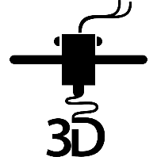

One Hands-On Tech club
Two Groups
3D Printing
Small Computers

Slide 3
New to the club? Welcome!
Wondering what H.O.T. is all about?
This is a hands-on group, so we may be in the middle of a series of meetings on our way to building something interesting
Go to handsontech.org>New Members for a specially designed launching point for new members!
Please take the time to look through a few presentations at handsontech.org>Small Computers or handsontech.org>3D Printing.
  Presentations are always available online after our meetings for reference and as self-paced projects

Slide 4
Club communications are via Email & Web !
To join our email list(s), fill membership form at handsontech.org>New Members
  When asked for your email address, use a gmail email address if possible (we use google forums & they are picky)
  You will be added automatically to our Hands-On Tech (H.O.T.) overall email list
  You will also be added to the Small Computers and/or 3D Printing mailing lists and forums if you expressed interest in the membership form.
Meeting calendar is at handsontech.org

Slide 5
Small Computers and Robots
Small Computers have become powerful enough to be capable of running ROS (The Robot Operating System).
Today, we will explore ROS, but first let’s get some background in robots.

Slide 6
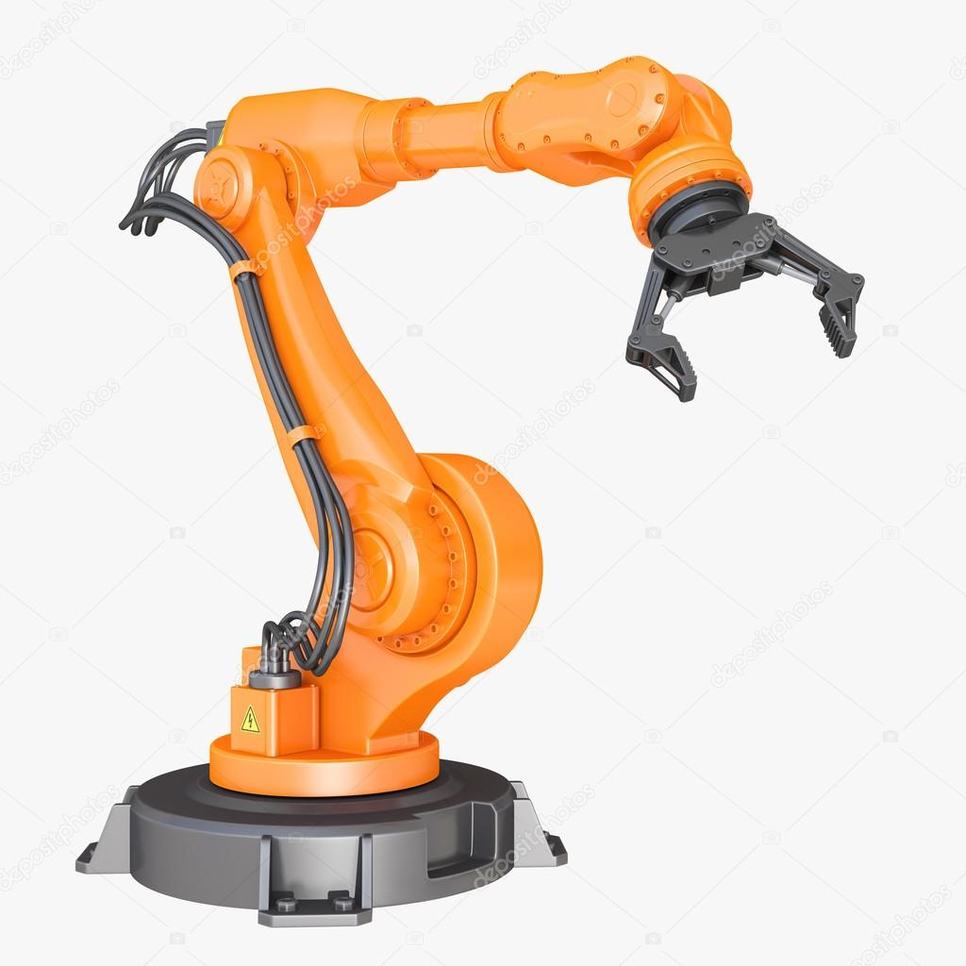
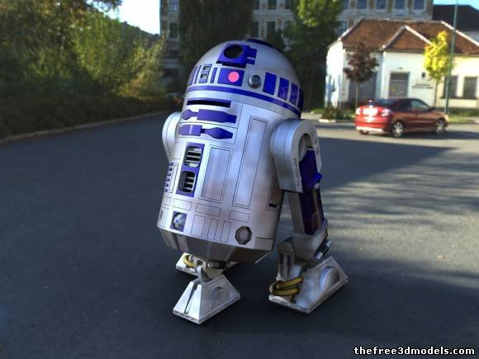
Different types of Robots
Mobile Robots
Industrial Robots
Robots with Articulated Joints

Slide 7
Common Mobility Configurations
Ackerman (like a car)
Differential drive (like a zero-turn mower)
  2 independent DOF: X and Theta-Z
Holonomic
  3 independent DOF: X, Y, Theta-Z
Other (Skid steer, Tank)

Slide 8
Control Capabilities
Tele-Op (Remote control)
Line Following
video
video

Slide 9
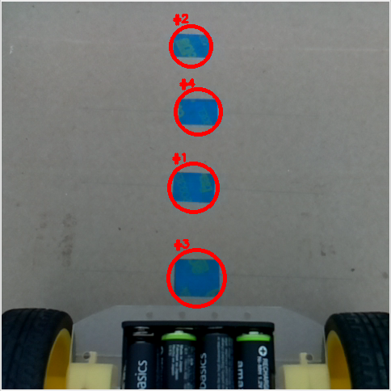
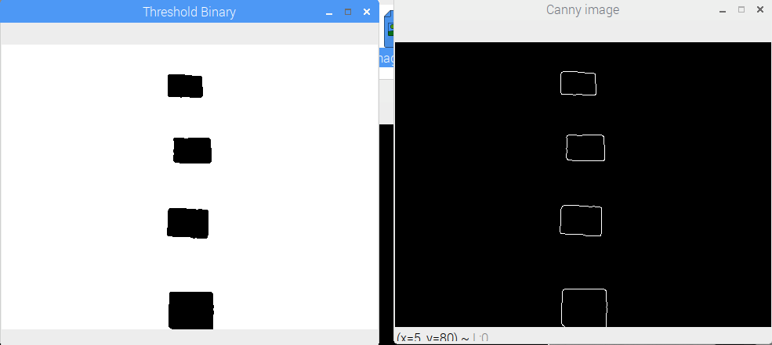
Image processing

Slide 10
Control Capabilities
Tele-Op (Remote control)
Line Following
Obstacle Avoiding
Mowing the Lawn
  ex: Early robotic vacuum cleaner
Autonomous Navigation
  ex: Newer robot vacuum cleaner
video

Slide 11
Autonomous navigation
Getting from point A to Point B
The robot needs to know where it is:
  A Map would be nice
  It needs to discover where it is on the map
    Cameras?
    GPS?
    Lidar?
In order to drive to a goal position
  Path Planning
  Detect and avoid obstacles

Slide 12
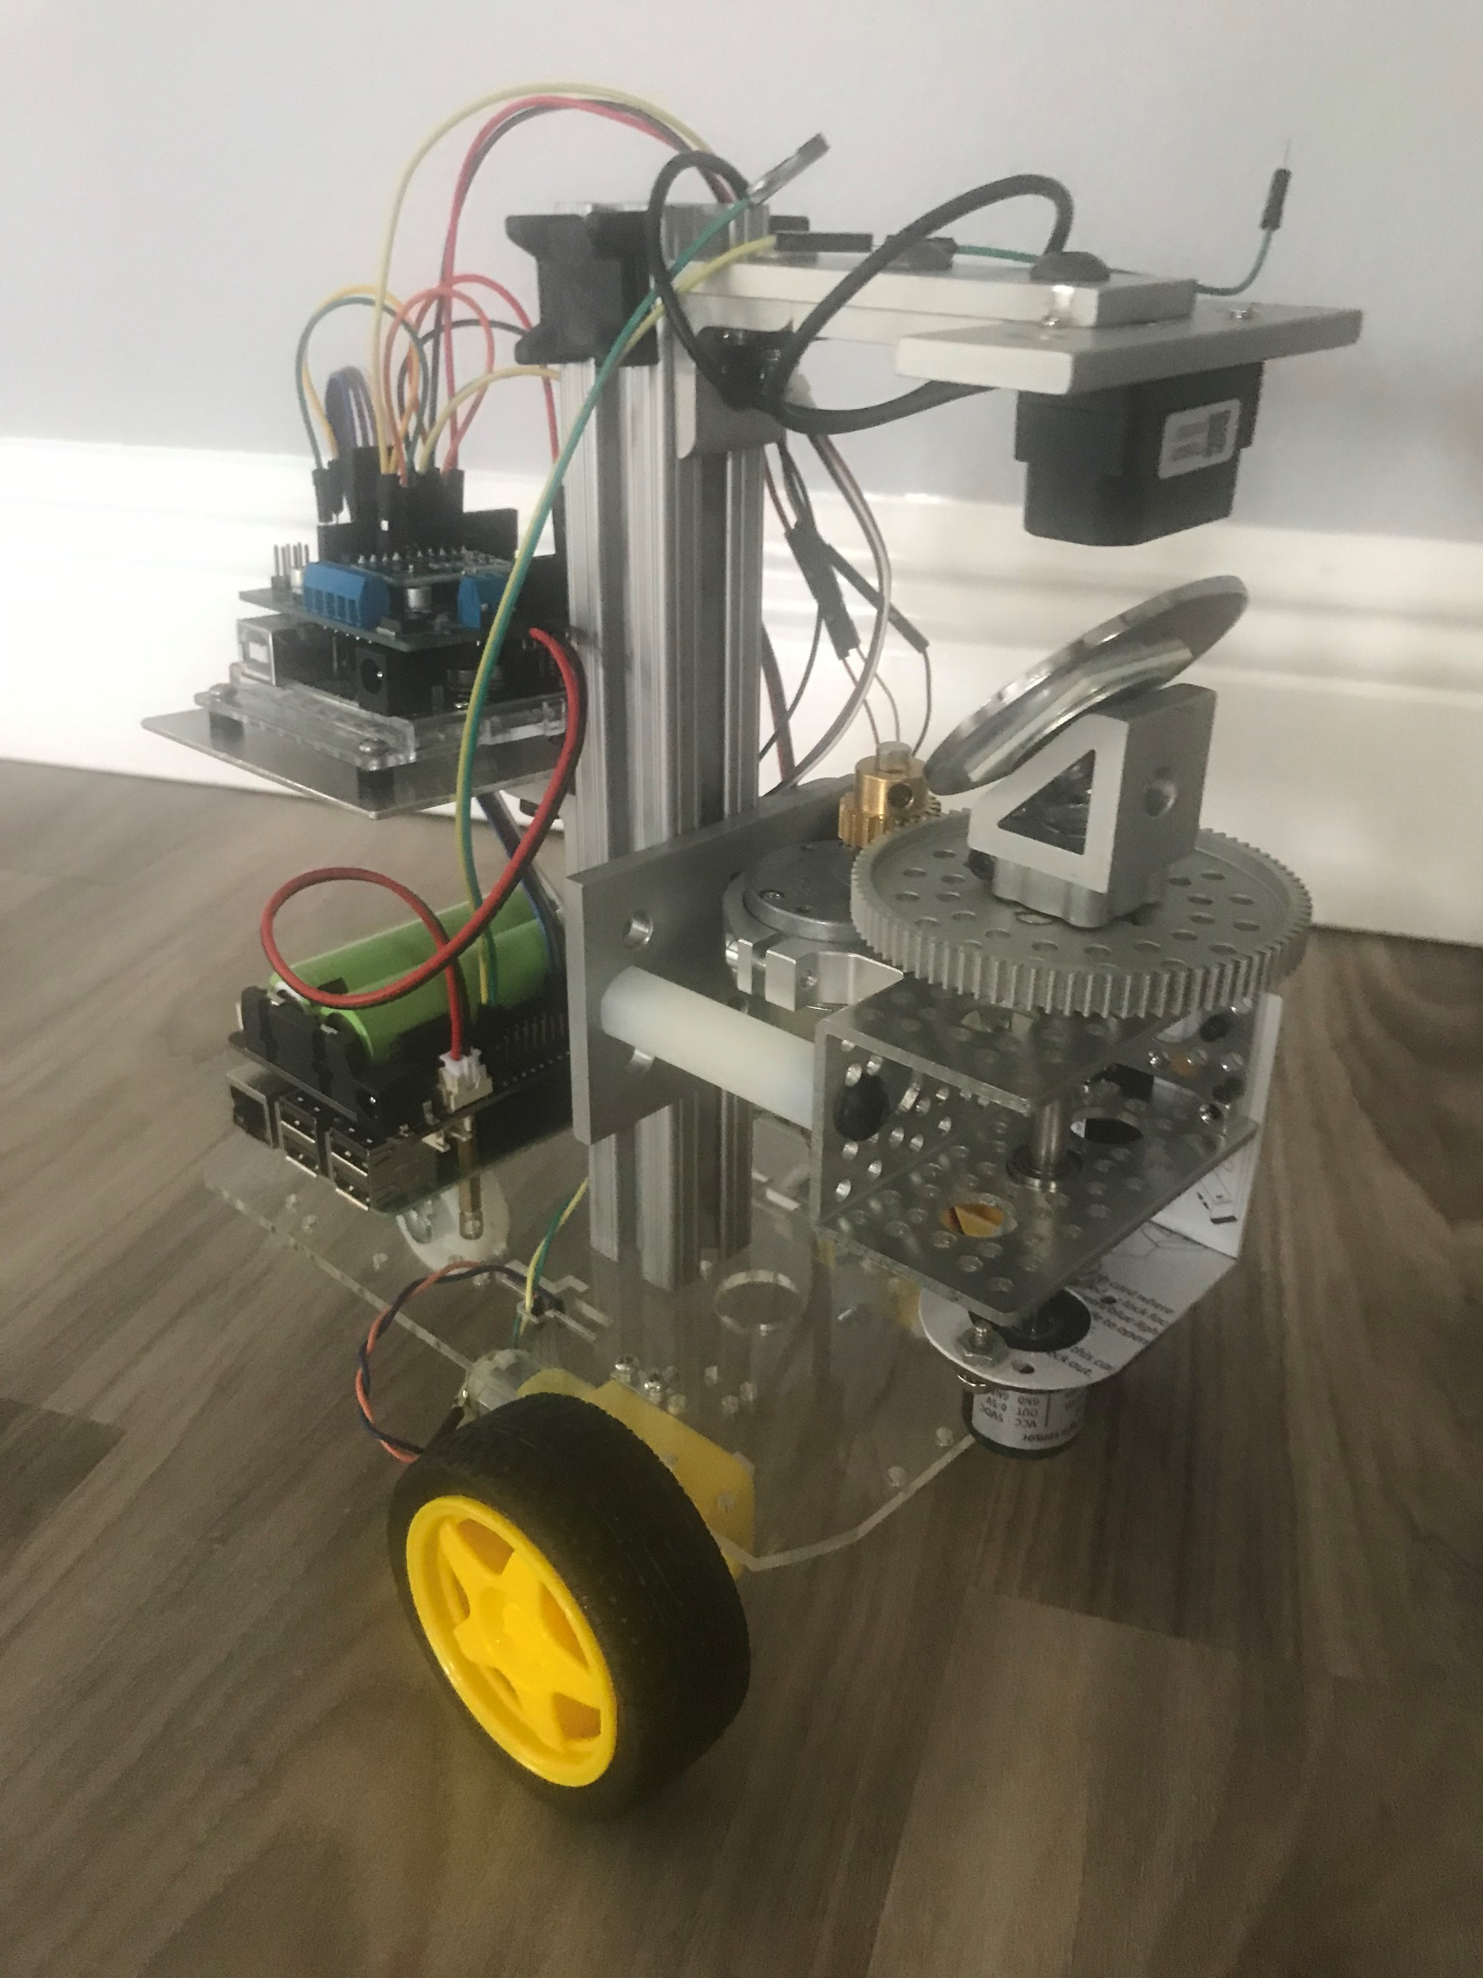
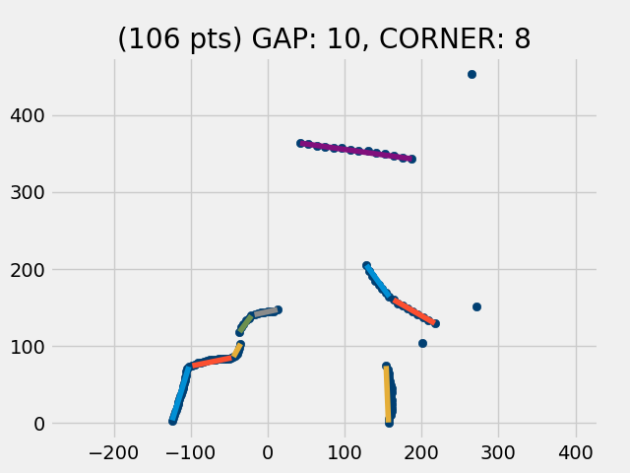
Diff drive Robot with LiDAR & IMU

Slide 13
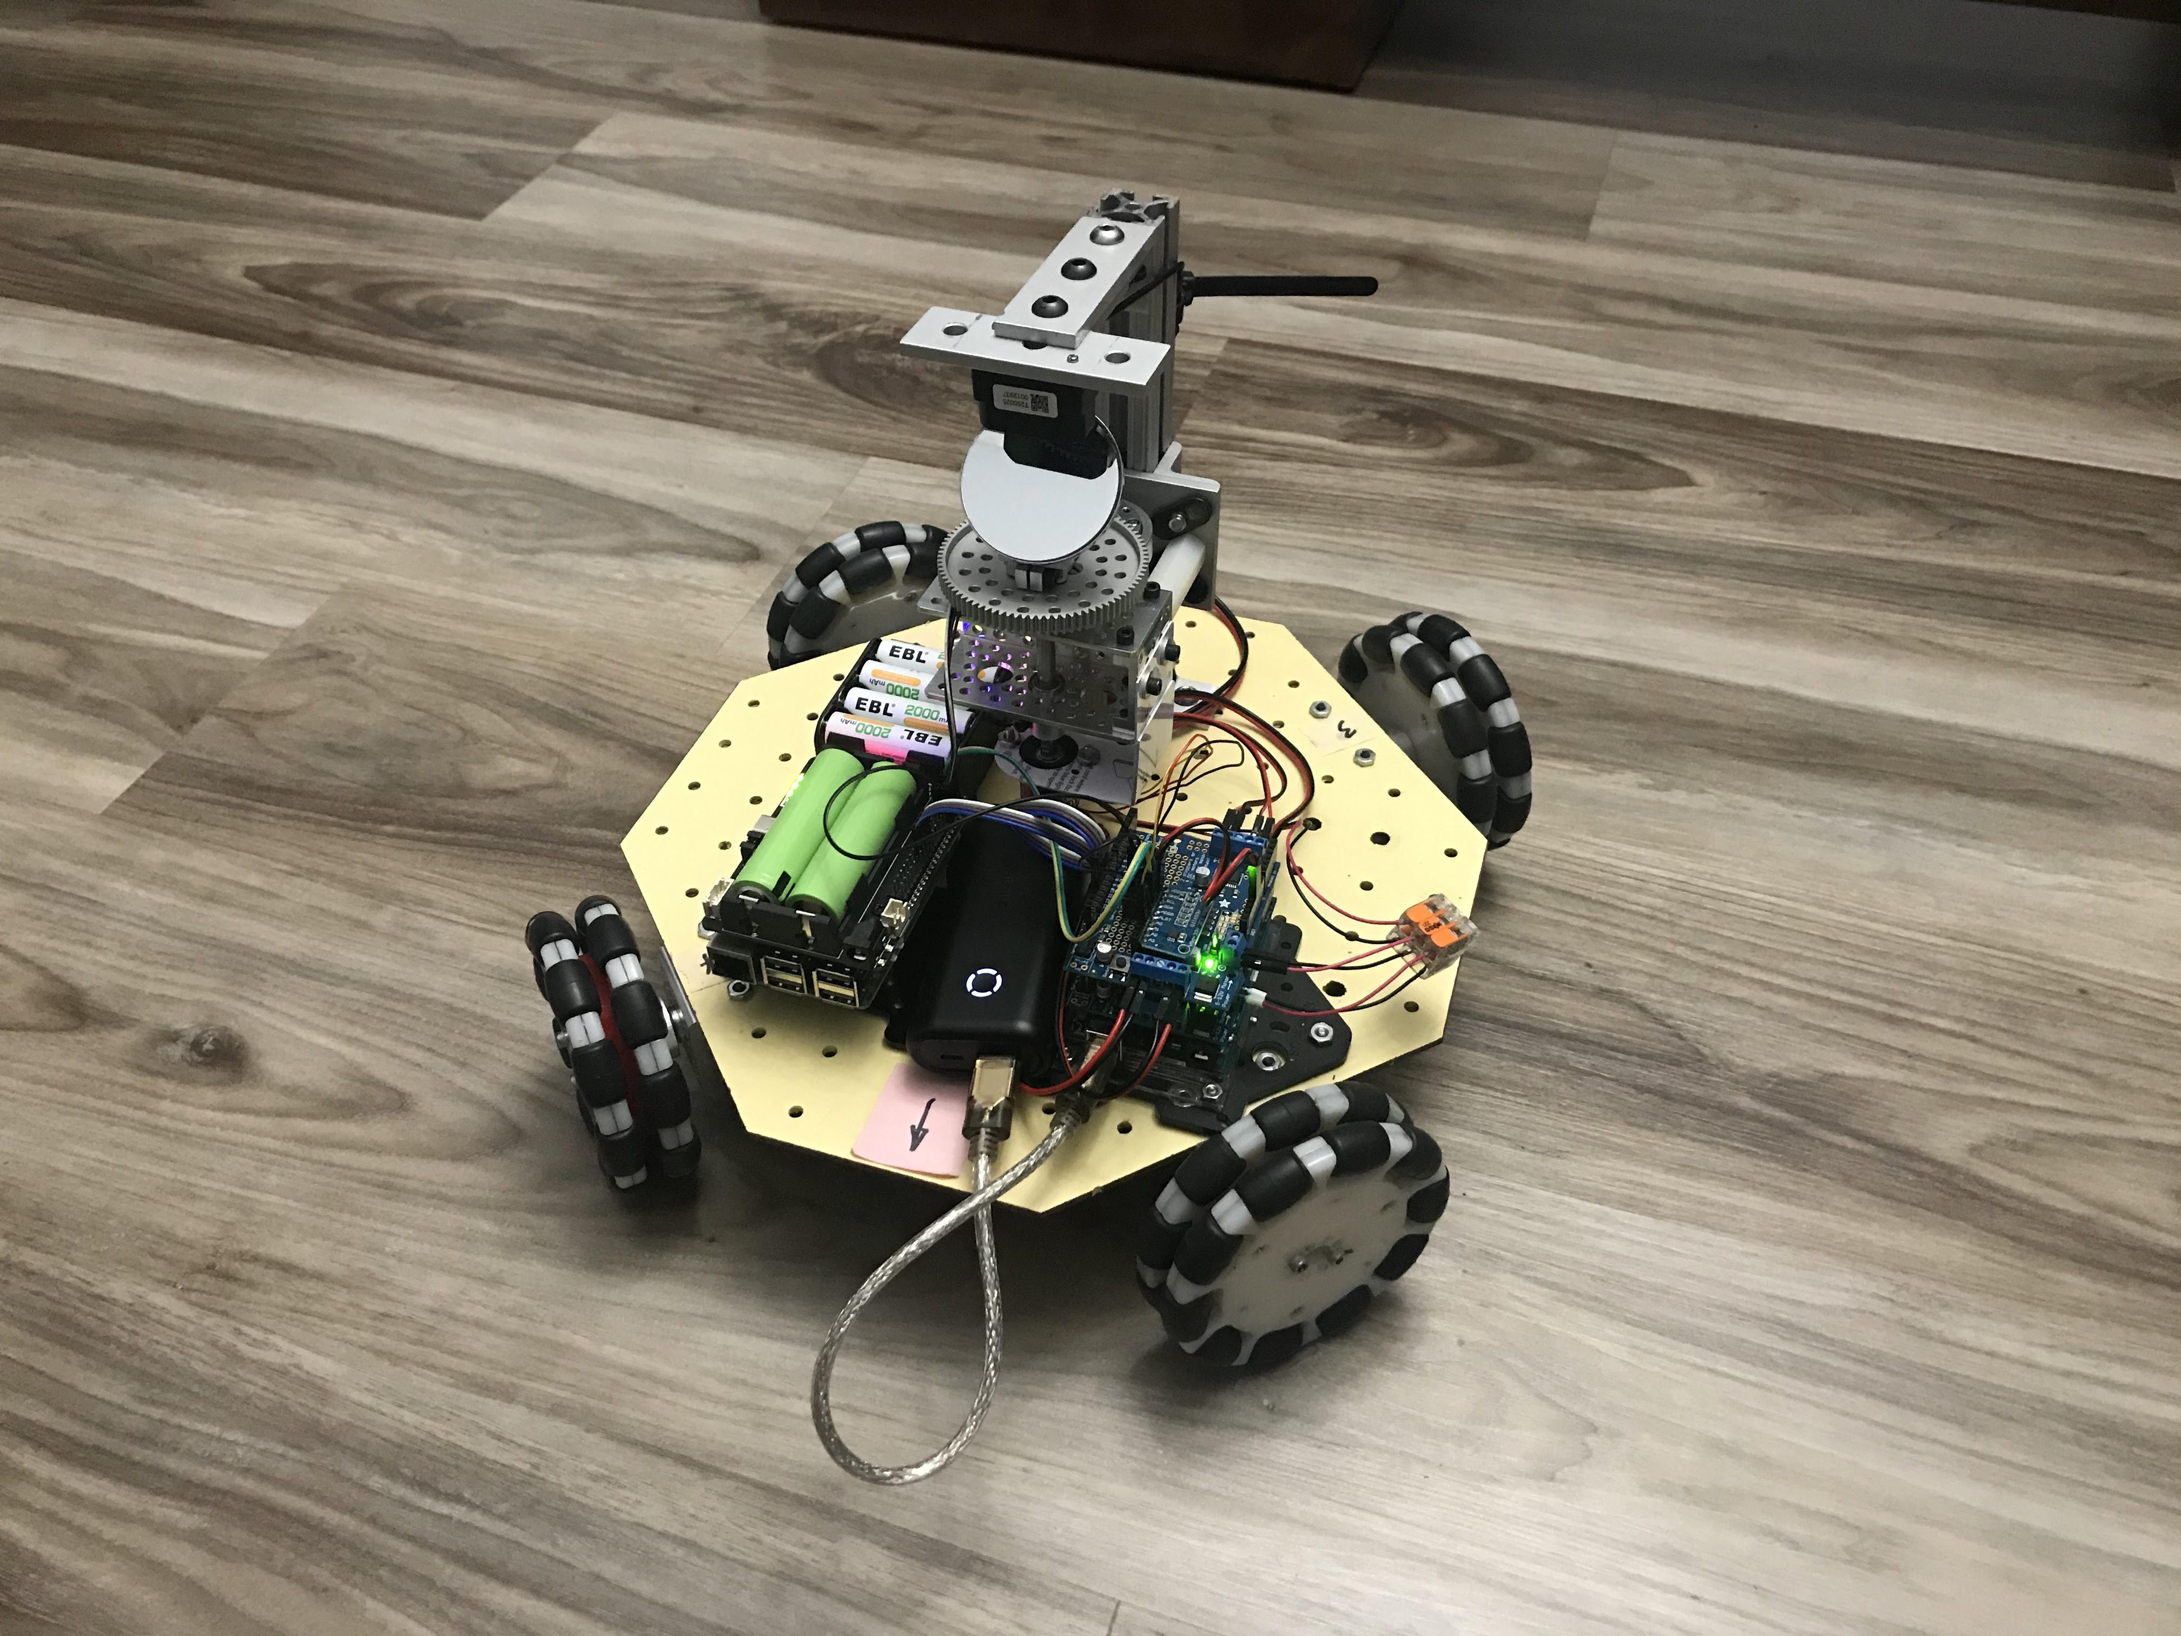
Holonomic robot w/ LiDAR and IMU
Omni-wheel robot

Slide 14
ROS provides many needed functions
Maps its environment
Localization (where am I on map?)
Sensor Fusion (odometer & IMU)
Path planning to goal pose
Obstacle Avoiding

Slide 15
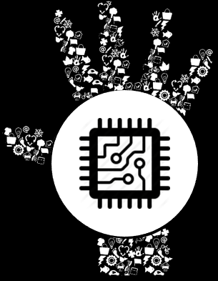

What Is ROS?

Slide 16
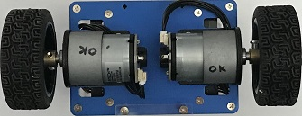
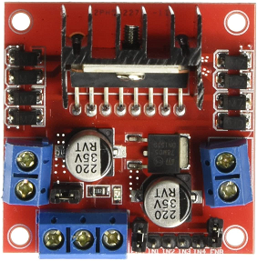
/right_ticks
/left_ticks
/act_vel
Odometry
Publisher
Tick Counter
/odom
/tf
/cmd_vel
Motor
Controller

Slide 17
What is ROS?
Not an OS, but a middle-ware
Currently runs best on linux (Ubuntu)
Defacto standard in robotics community
Handles communication between processes called “Nodes”
Nodes can be stopped/started on the fly
Nodes can run on different computers
  Distribution of processing load
  Collaboration between robots

Slide 18
How ROS works
Roscore node is started first
  Coordinates communication between nodes
  Serves as master clock
  Parameter server
  Package manager
New nodes register with roscore
  Specify topics they want to subscribe to
  Specify topics they will publish

Slide 19
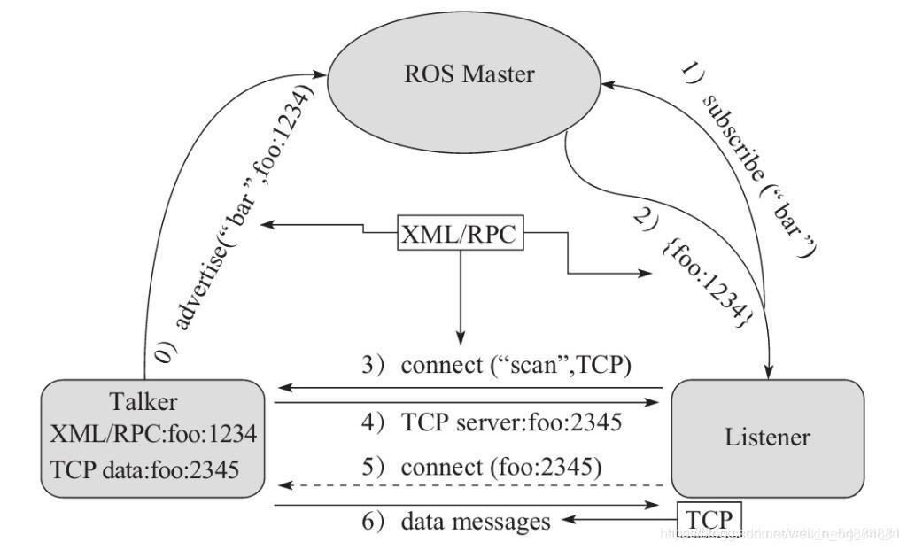
How ROS communication works
ROS communicates via TCP
Roscore is at ROS_MASTER_URI=http://raspi4:11311/

Slide 20
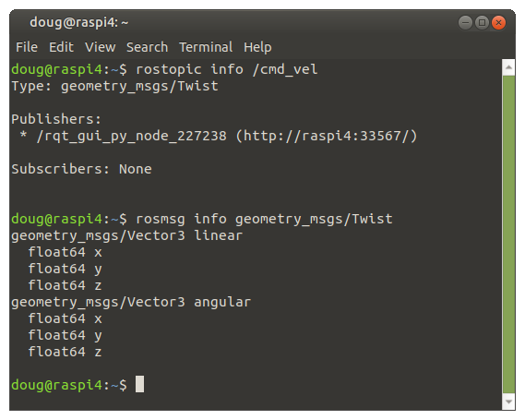
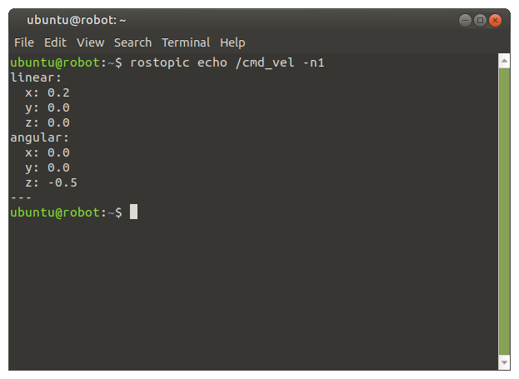
How ROS communication works
A Message is published over a channel called a Topic
Example: the /cmd_vel topic contains a Twist message

Slide 21
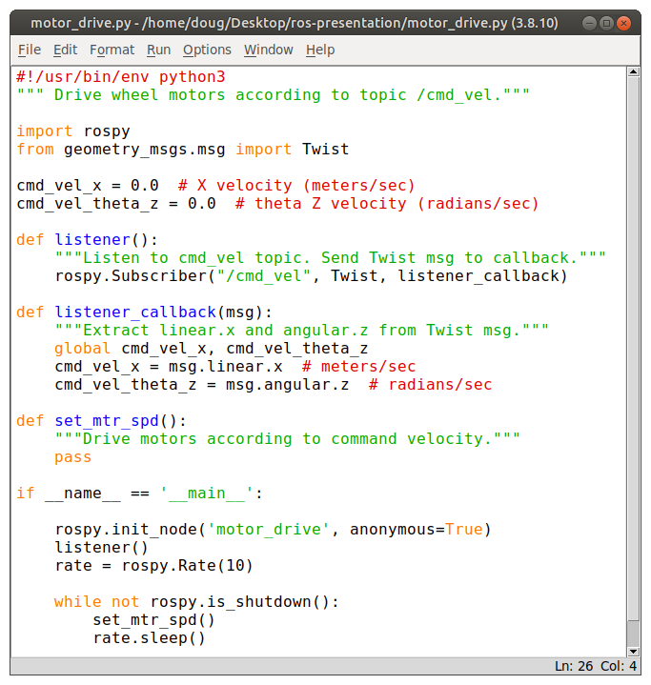
A Python program (node) to drive motors
Import rospy, Twist
Register w/ roscore
Subscribe to /cmd_vel
  Listener()
  Listener_callback()
Set loop rate to 10 Hz
  Drive motors

Slide 22
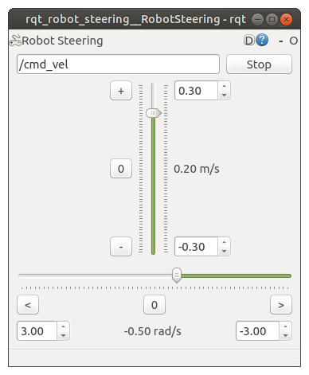
Robot Steering tool used to steer robot
Standard GUI tool
Command-line launched
User setable velocities
  X (Linear)
  Theta Z (Angular)
Publishes /cmd_vel @ 10 Hz

Slide 23
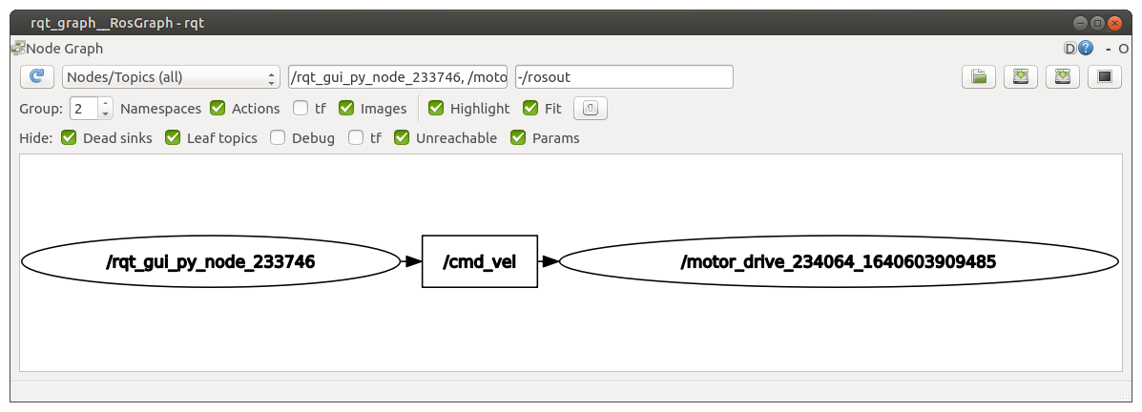
Use rqt_graph to explore nodes / topics

Slide 24
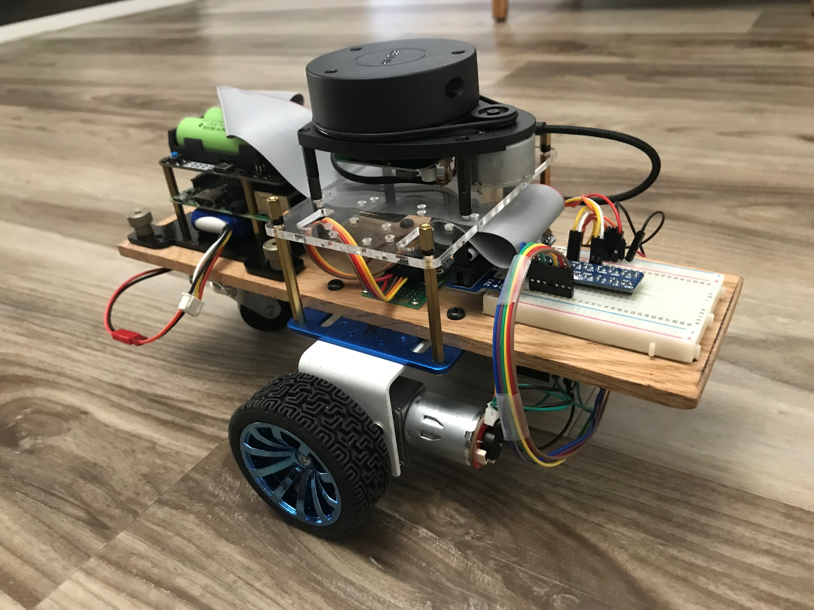
Let’s build a simple robot
Differential drive
Laser scan
IMU

Slide 25
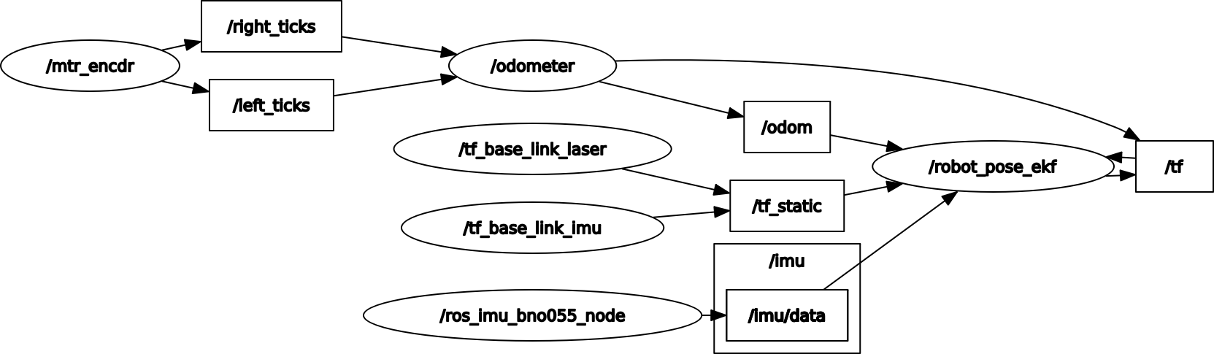
Node-Topic graph for our simple robot

Slide 26
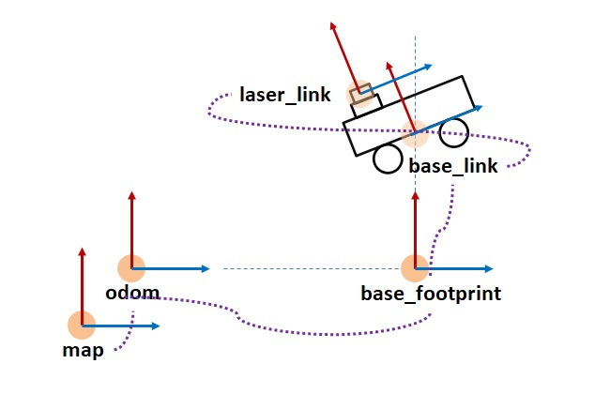
Coordinate Frames

Slide 27
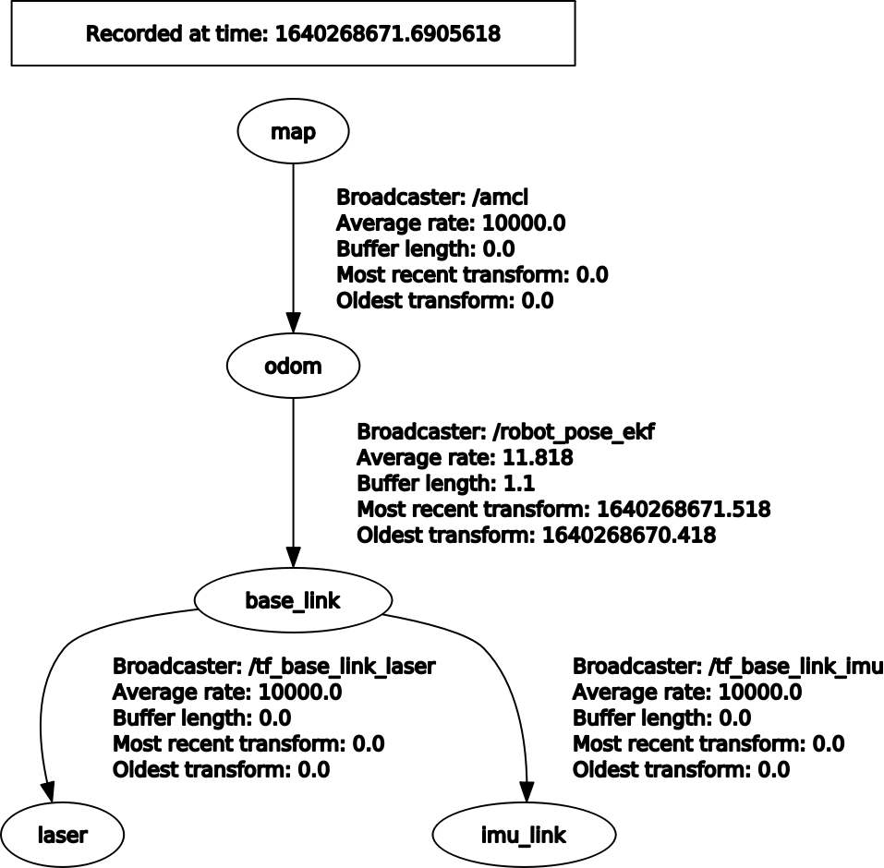
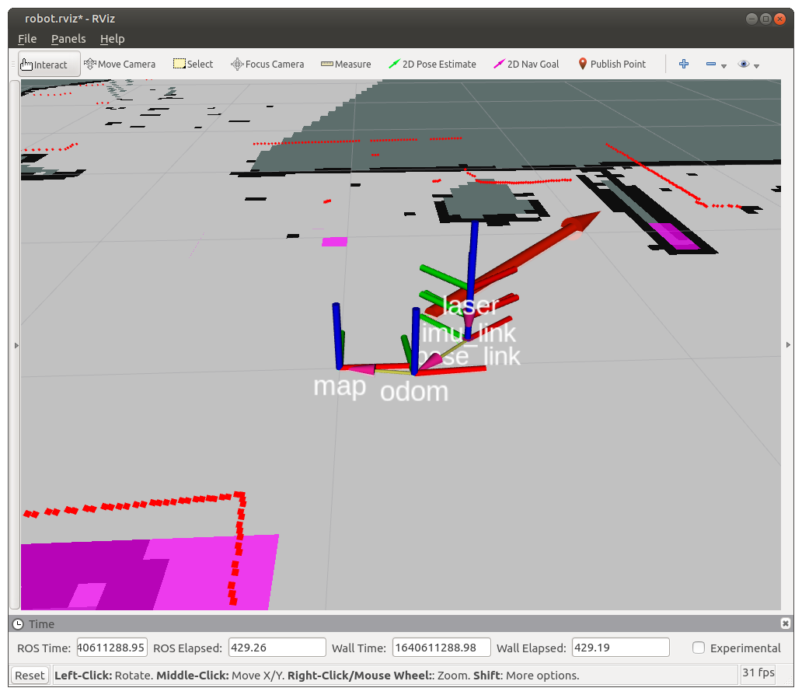
Coordinate Frames of our Robot

Slide 28
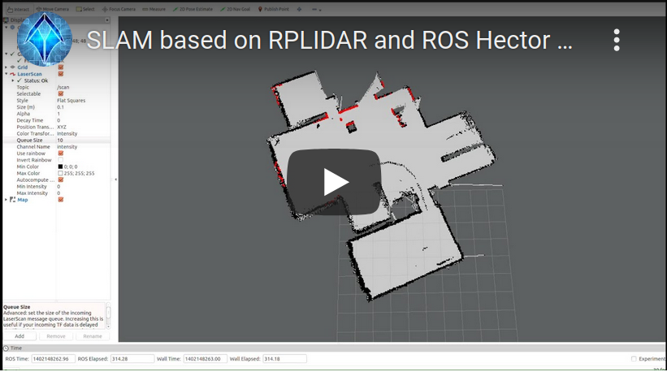
How the robot builds the map
video

Slide 29
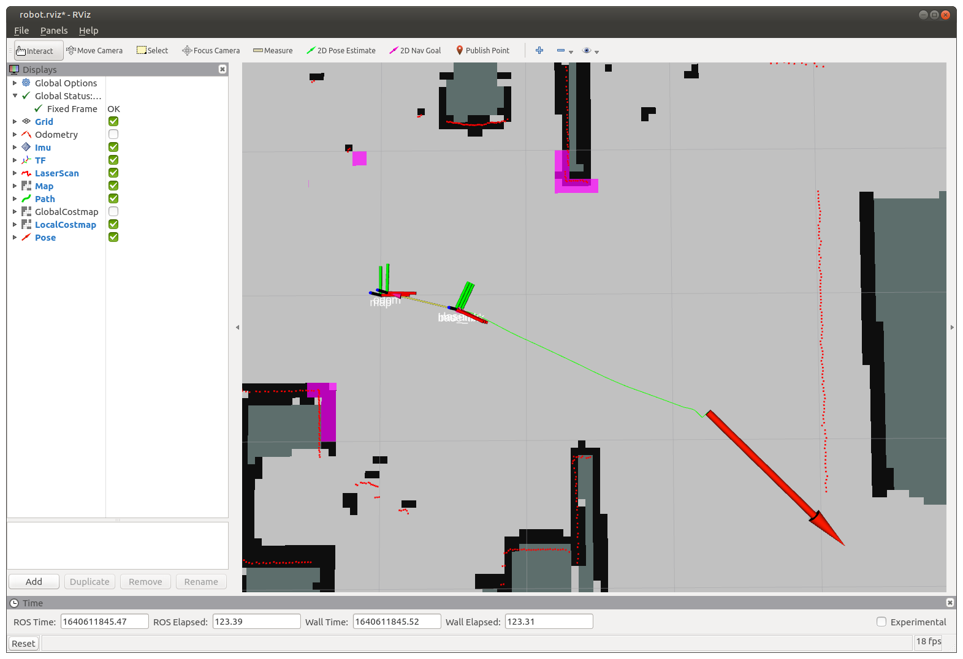
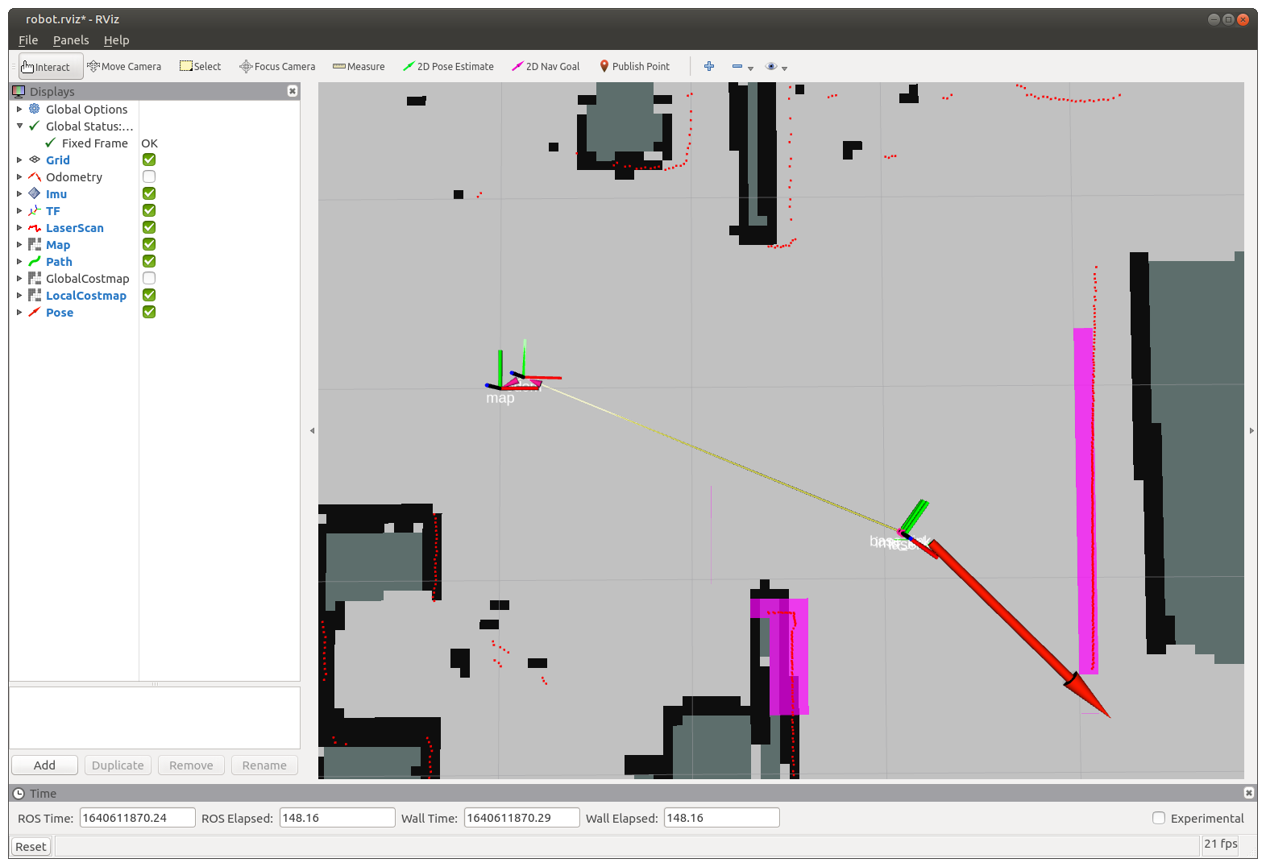
Path Planning

Slide 30
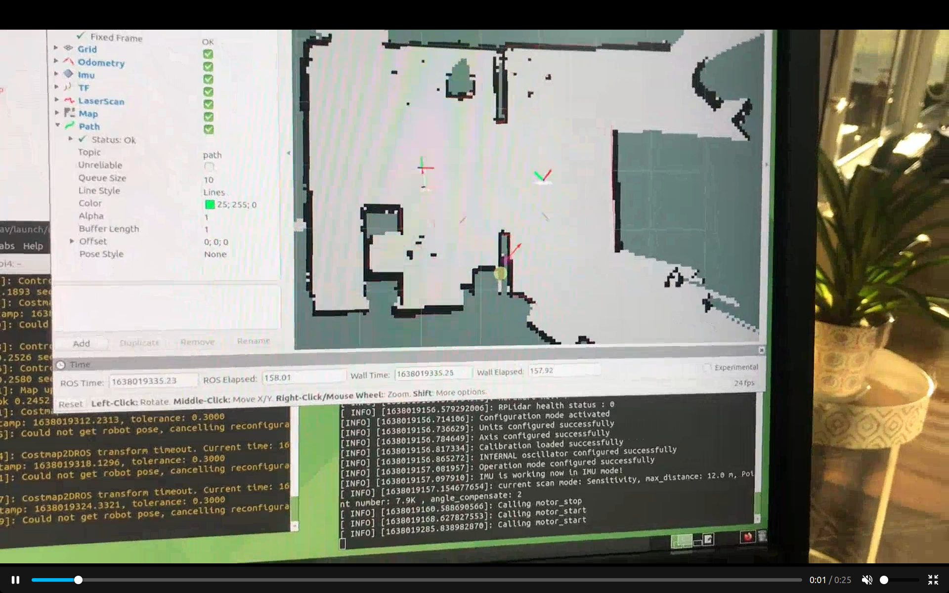
The robot drives to Goal Pose
video

Slide 31
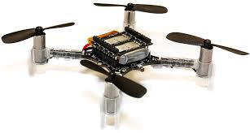
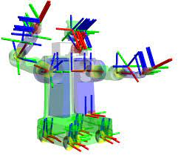
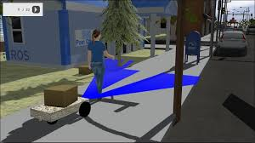
Other things ROS does...
Drones
Articulated Robots
Simulation

Slide 32
How to Learn ROS
Online tutorials at wiki.ros.org/tutorials
Automatic Addison online tutorials
Book: Practical Robotics in C++ by Lloyd Brombach
Robot Ignite Academy
Digital Book: ROS_Robot_Programming_EN.pdf

